Slide 1
Phase-field modeling of solute precipitation / dissolution using MOOSE: A finite element method
Zexuan Xu^{1,2}, Hai Huang¹, Zhijie Xu³, Paul Meakin¹
1. Idaho National Laboratory, Idaho Falls, ID 83401, USA
2. Department of Earth, Ocean and Atmosphere Science, Florida State University, Tallahassee, FL 32306, USA
3. Pacific Northwest National Laboratory, Richland, WA 99352, USA

Slide 2
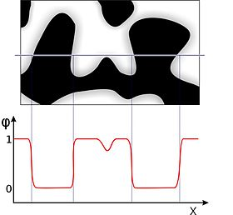
Phase field model
Mathematical model for solving interfacial problems
Two distinct values (-1 and +1) in each of the phases (solid and liquid)
Free energy function
Gradient energy density (chemical potential)
Gradient free energy function
Local free energy function: a double well function

Slide 3
Problem and Method
Precipitation / Dissolution
A (solid) <-------------------------------------> A (liquid)
Not real chemical reaction: A + B = C
Finite element method (FEM) using MOOSE, a framework to solve partial differential equation (PDE) by Newton’s method
We only need to write down the weak form and jacobian of PDE, and implement the equations in code (C++)

Slide 4
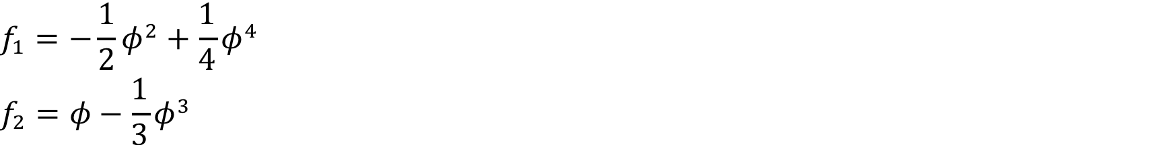
Equations
Governing equations:
, Ce is equlibrium concentration
Local energy funciton:
Xu and Meakin, 2008, Phase-field modeling of solute precipitation and dissolution, The Journal of Chemical Physics, 129, 014705.

Slide 5
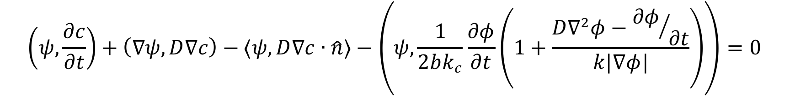
Equations
Curvature
Weak Form
Sun and Beckermann, 2007, Sharp interface tracking using the phase-field equation. Journal of Computational Physics, 220(2), 628-653.

Slide 6
Dimensionless equations
Xu and Meakin, 2011. Phase-field modeling of two-dimensional solute precipitation/dissolution: Solid finger and diffusion-limited precipitation, Journal of Chemical Physics, 134, 044137.

Slide 7
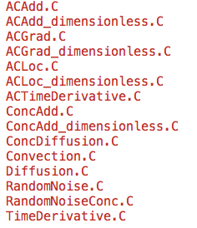
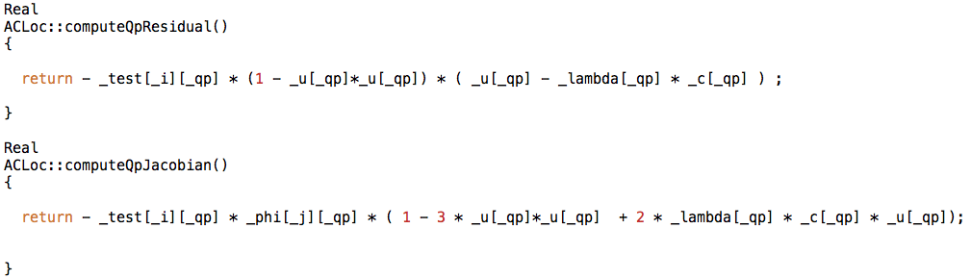
Code framework
include # C++ header file
src # C++ source code file
base
Ics (initial conditions)
kernels
materials

Slide 8
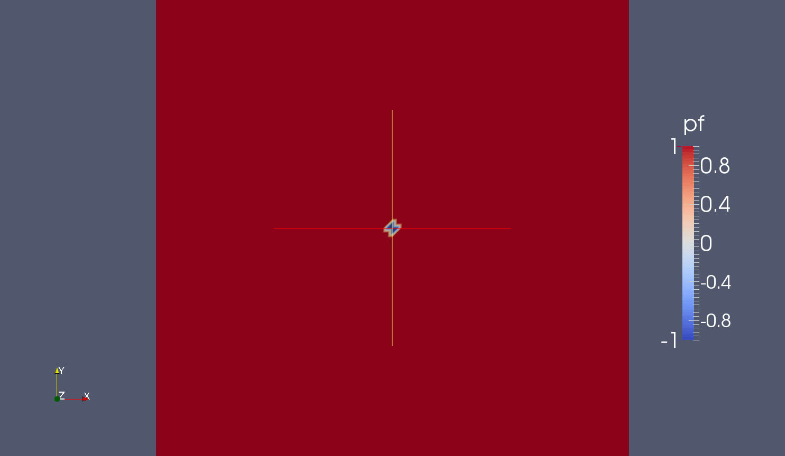
Dendrite growth (reaction-limited case)
Damkohler number ≈ 1 (low reaction rate relatively to diffusion)
Mesh: 50 × 50
Domain: 10.0 × 10.0
Reaction rate: 5.0
Diffusion coef: 0.5
Epsilon: 0.05
dt = 0.005
Timestep = 200

Slide 9
Dendrite growth (diffusion-limited case)
Damkohler number ≈ 50,000
dt = 0.01
Timestep = 80

Slide 10

Dendrite growth (sidebranch)
Damkohler number > 10,000
Random noise was introduced
α is the amplitude of noise
n is random number
dt = 0.01
Timestep = 80

Slide 11
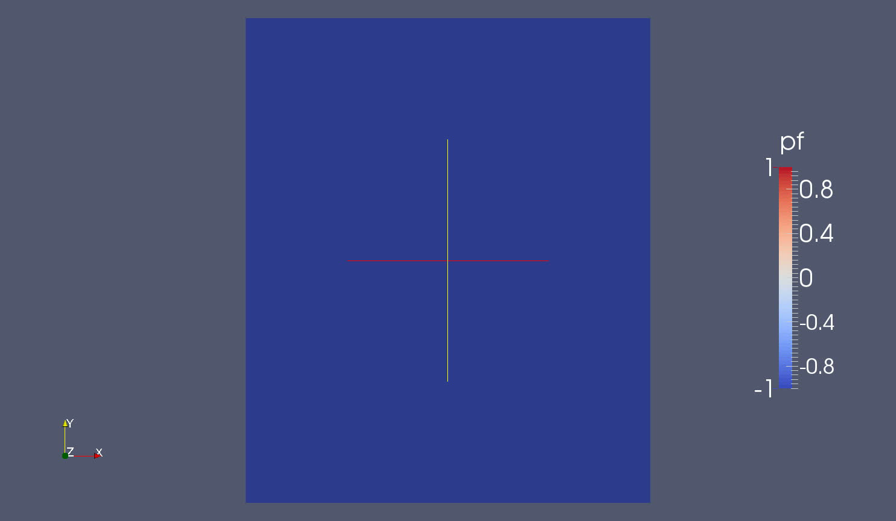
Dissolution
All parameters are the same as sidebranch case with random noise

Slide 12
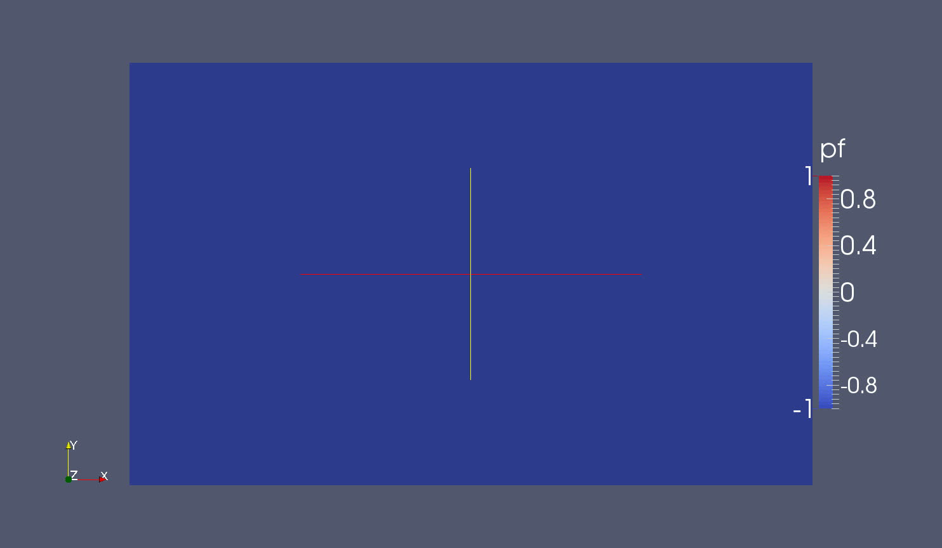
Dissolution (point source)
Dissolution progress is slow
dt = 0.01
Timestep = 100

Slide 13
Dissolution (point source, with convenction)
All parameters are same, except add a convenction term along x axis

Slide 14
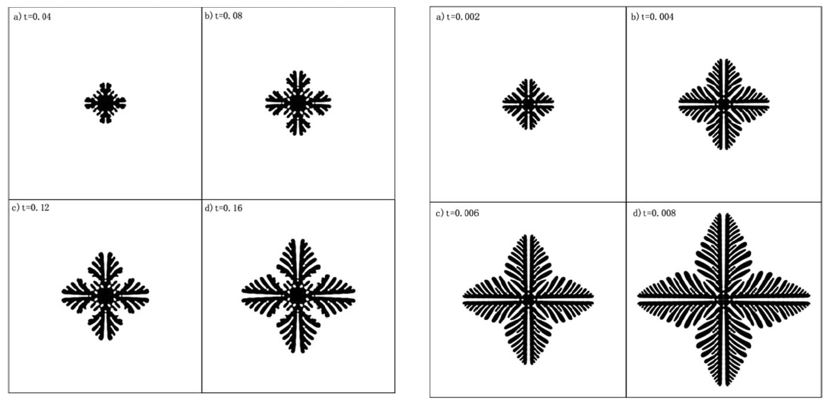
Something needs to improve
Solid finger effect (diffuesd-limited case)
We still cannot do that!
Xu and Meakin, 2011. Phase-field modeling of two-dimensional solute precipitation/dissolution: Solid finger and diffusion-limited precipitation, Journal of Chemical Physics, 134, 044137.

Slide 15
Possible reasons
Different methods: finite element & finite difference
Anisotropic: random noise
Curvature expression
Parameters chosen
Code implementation

Slide 16
What’s next?
Phase field model with chemical reaction
A + B = C
Explore new governing equations

Slide 17
Selected references
Gaton et al., 2009. MOOSE: A parellel computational framework for coupled systems of nonlinear equations. Nucl. Eng. Des. 239, 1768-1778.
Karma and Rappel, 1999, Phase-field model of dendritic sidebranching with thermal noise, Physical review E, 60(4), 3614-3625.
Tonks et al., 2012, An object-oriented finite element framework for multiphysics phase field simulations, Computational Materials Science, 51, 20-29.
Sun and Beckermann, 2007, Sharp interface tracking using the phase-field equation. Journal of Computational Physics, 220(2), 628-653.
Xu and Meakin, 2008, Phase-field modeling of solute precipitation and dissolution, The Journal of Chemical Physics, 129, 014705.
Xu and Meakin, 2011. Phase-field modeling of two-dimensional solute precipitation/dissolution: Solid finger and diffusion-limited precipitation, Journal of Chemical Physics, 134, 044137.
Xu et al., 2012. Phase field and level set methods for modeling solute precipitation and/or dissolution. Computer Physics Communications. 183, 15-19.

